Slide 1
Survey Tool Review
Robin Harrison, robin.harrison@digital.homeoffice.gov.uk
Sulthan Ahmed, sulthan.ahmed@digital.homeoffice.gov.uk
Notes:
Use this guide for all internal and external presentations - you can save and overwrite these slides. Before you start, remember to:
keep slides simple and clear - stick to one thing per page with any extra information in the speaker notes
ask people beforehand if they have any additional access needs and what those may be. For example, if they require large print, ask them what size, font, etc and supply them with a copy in landscape format

Slide 2
Evaluate survey tools for use in:
the wider Home Office
the Digital Inclusion survey
Notes:
Each bullet should read as a full sentence from the lead in line. Use the GOV.UK style guide to be sure.

Slide 3
3 main candidates
Survey Monkey – most recognisable
Smart Survey – already licensed in HOD
Lime Survey – largest open source alternative
Notes:
Each bullet should read as a full sentence from the lead in line. Use the GOV.UK style guide to be sure.

Slide 4
Survey Monkey
90M survey responses per month
Use by Facebook, Virgin America, Salesforce
Based in California, USA
Notes:
Each bullet should read as a full sentence from the lead in line. Use the GOV.UK style guide to be sure.

Slide 5
Smart Survey
2.5M survey responses a year
Use by Home Office, BBC, Microsoft, NHS
Based in UK
Notes:
Each bullet should read as a full sentence from the lead in line. Use the GOV.UK style guide to be sure.

Slide 6
Lime Survey
Open source GPL
PHP codebase
First release in 2003
Notes:
Each bullet should read as a full sentence from the lead in line. Use the GOV.UK style guide to be sure.

Slide 7
Findings
Notes:
You can use a colour block like this to help break up presentations, show a new speaker etc.

Slide 8
Survey Usage
 | Survey Monkey | Smart Survey | Lime Survey
Usability | Good | Good | Poor
Offline | No | Yes | Yes*
Requires JavaScript | Yes | Yes | Yes
Notes:
Some table styles.

Slide 9
Survey Creation & Customisation
 | Survey Monkey | Smart Survey | Lime Survey
Usability | Very Good | Good | Poor
Advance Logic | Good | Very Good | Poor
Validation | Good | Good | Fair
Tracking Data | Good | Good | Fair
Theming | Good | Very Good | Fair
Customisable | Poor | Poor | Fair
Question Types | Good | Good | Good
Notes:
Some table styles.

Slide 10
Survey Creation & Customisation
 | Survey Monkey | Smart Survey | Lime Survey
Documentation | Very Good | Good | Poor
Community | Very Good | None | Fair
Notes:
Some table styles.

Slide 11
Survey Monkey - Creation
Notes:
Some table styles.

Slide 12
Smart Survey - Creation
Notes:
Some table styles.

Slide 13
Lime Survey – Creation
Notes:
Some table styles.

Slide 14
Survey Monkey - Skip Logic
Notes:
Some table styles.

Slide 15
Smart Survey - Skip Logic
Notes:
Some table styles.

Slide 16
Lime Survey - Skip Logic
Notes:
Some table styles.

Slide 17
Reporting
 | Survey Monkey | Smart Survey | Lime Survey
Usability | Good | Good | Fair
Graphs/ Charts | Yes | Yes | Yes
Digital Inclusion | API / Excel | API / Excel | API / Excel
Export CSV | Yes | Yes | Yes
Export PDF | Yes | Yes | No
Notes:
Some table styles.

Slide 18
Survey Monkey - Reporting
Notes:
Some table styles.

Slide 19
Smart Survey - Reporting
Notes:
Some table styles.

Slide 20
Lime Survey - Reporting
Notes:
Some table styles.

Slide 21
API
 | Survey Monkey | Smart Survey | Lime Survey
Control Form | No | No | No
Ease of Use | Good | Good | Poor
Documentation | Very Good | Very Good | Very Poor
Format | REST | REST | RPC
Security | Token | Token | Login
Extract Data | Yes | Yes | Yes
Notes:
Some table styles.

Slide 22
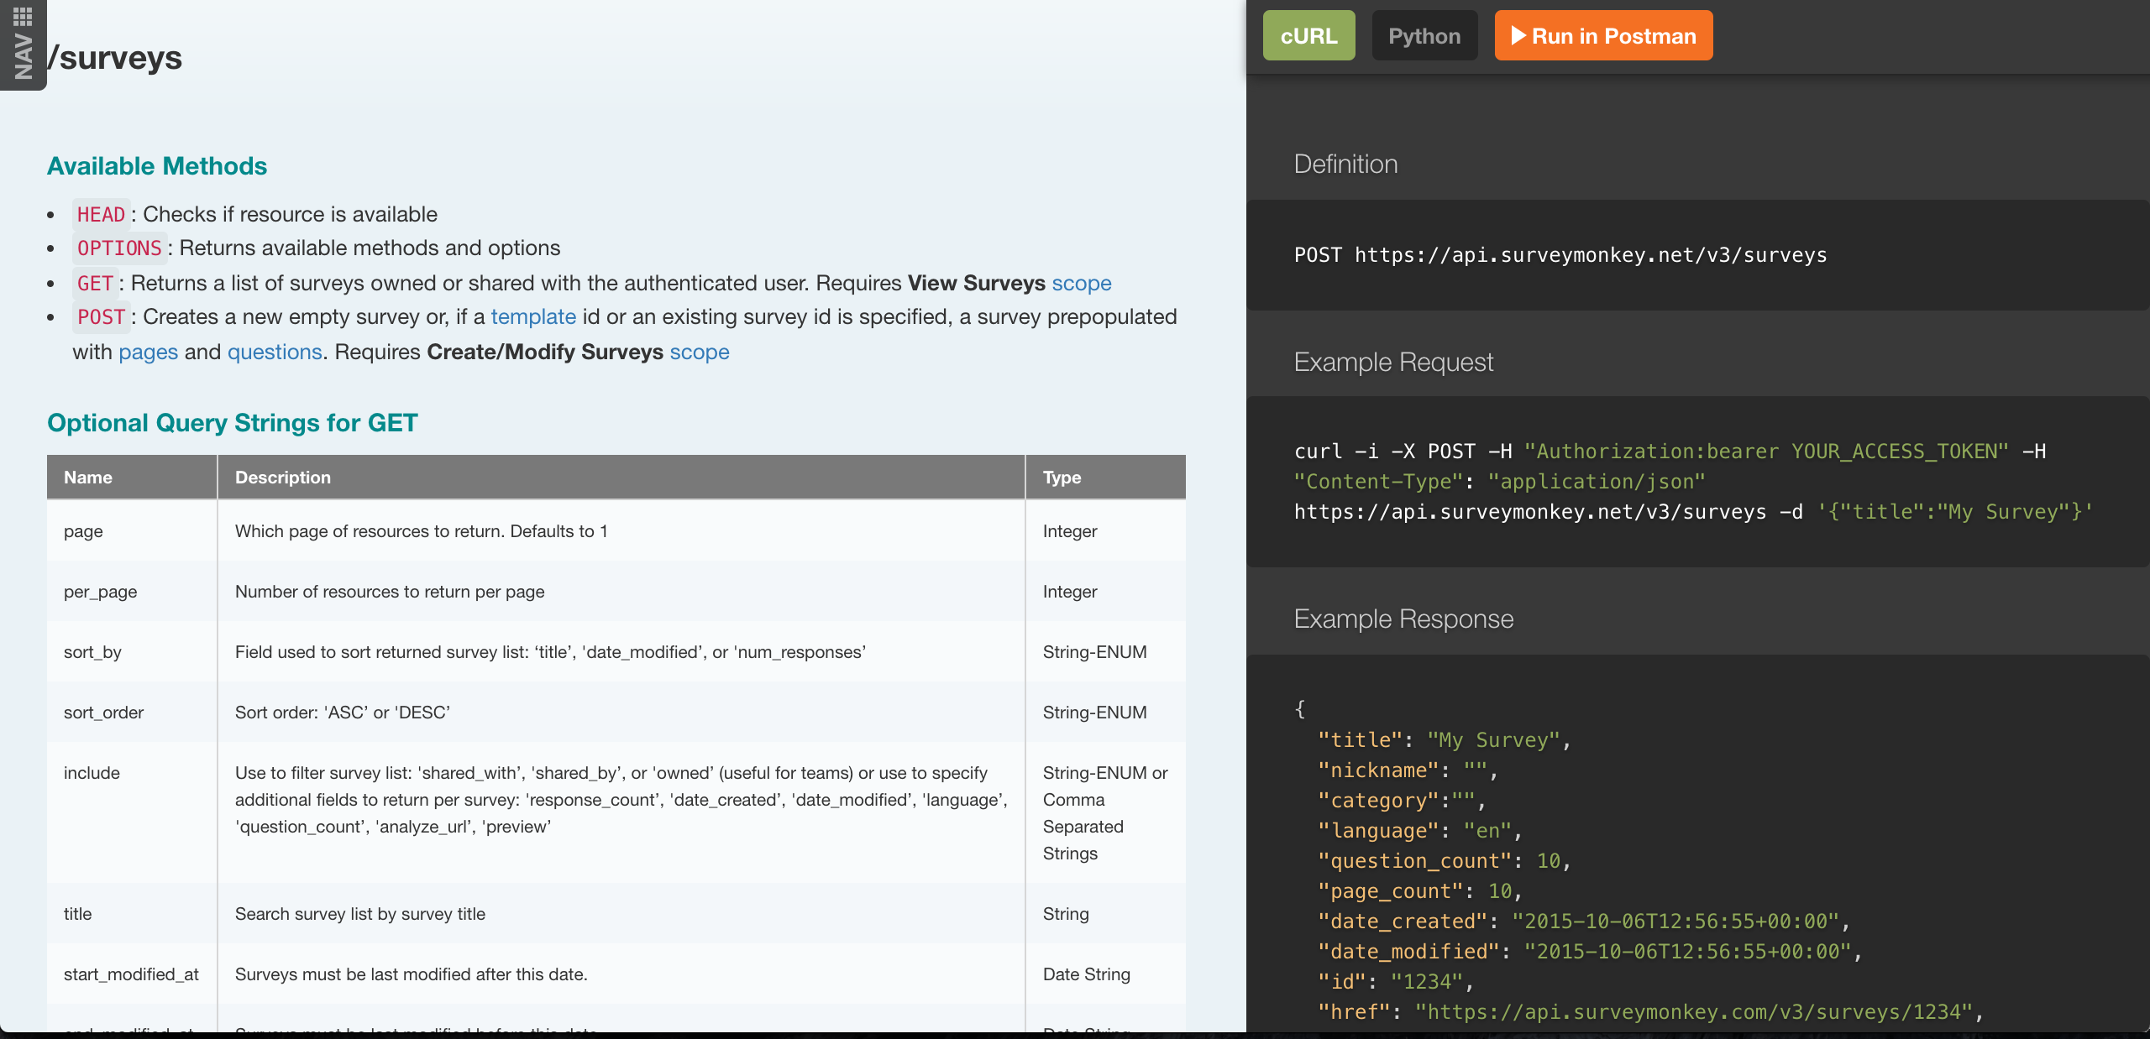
Notes:
Some table styles.

Slide 23
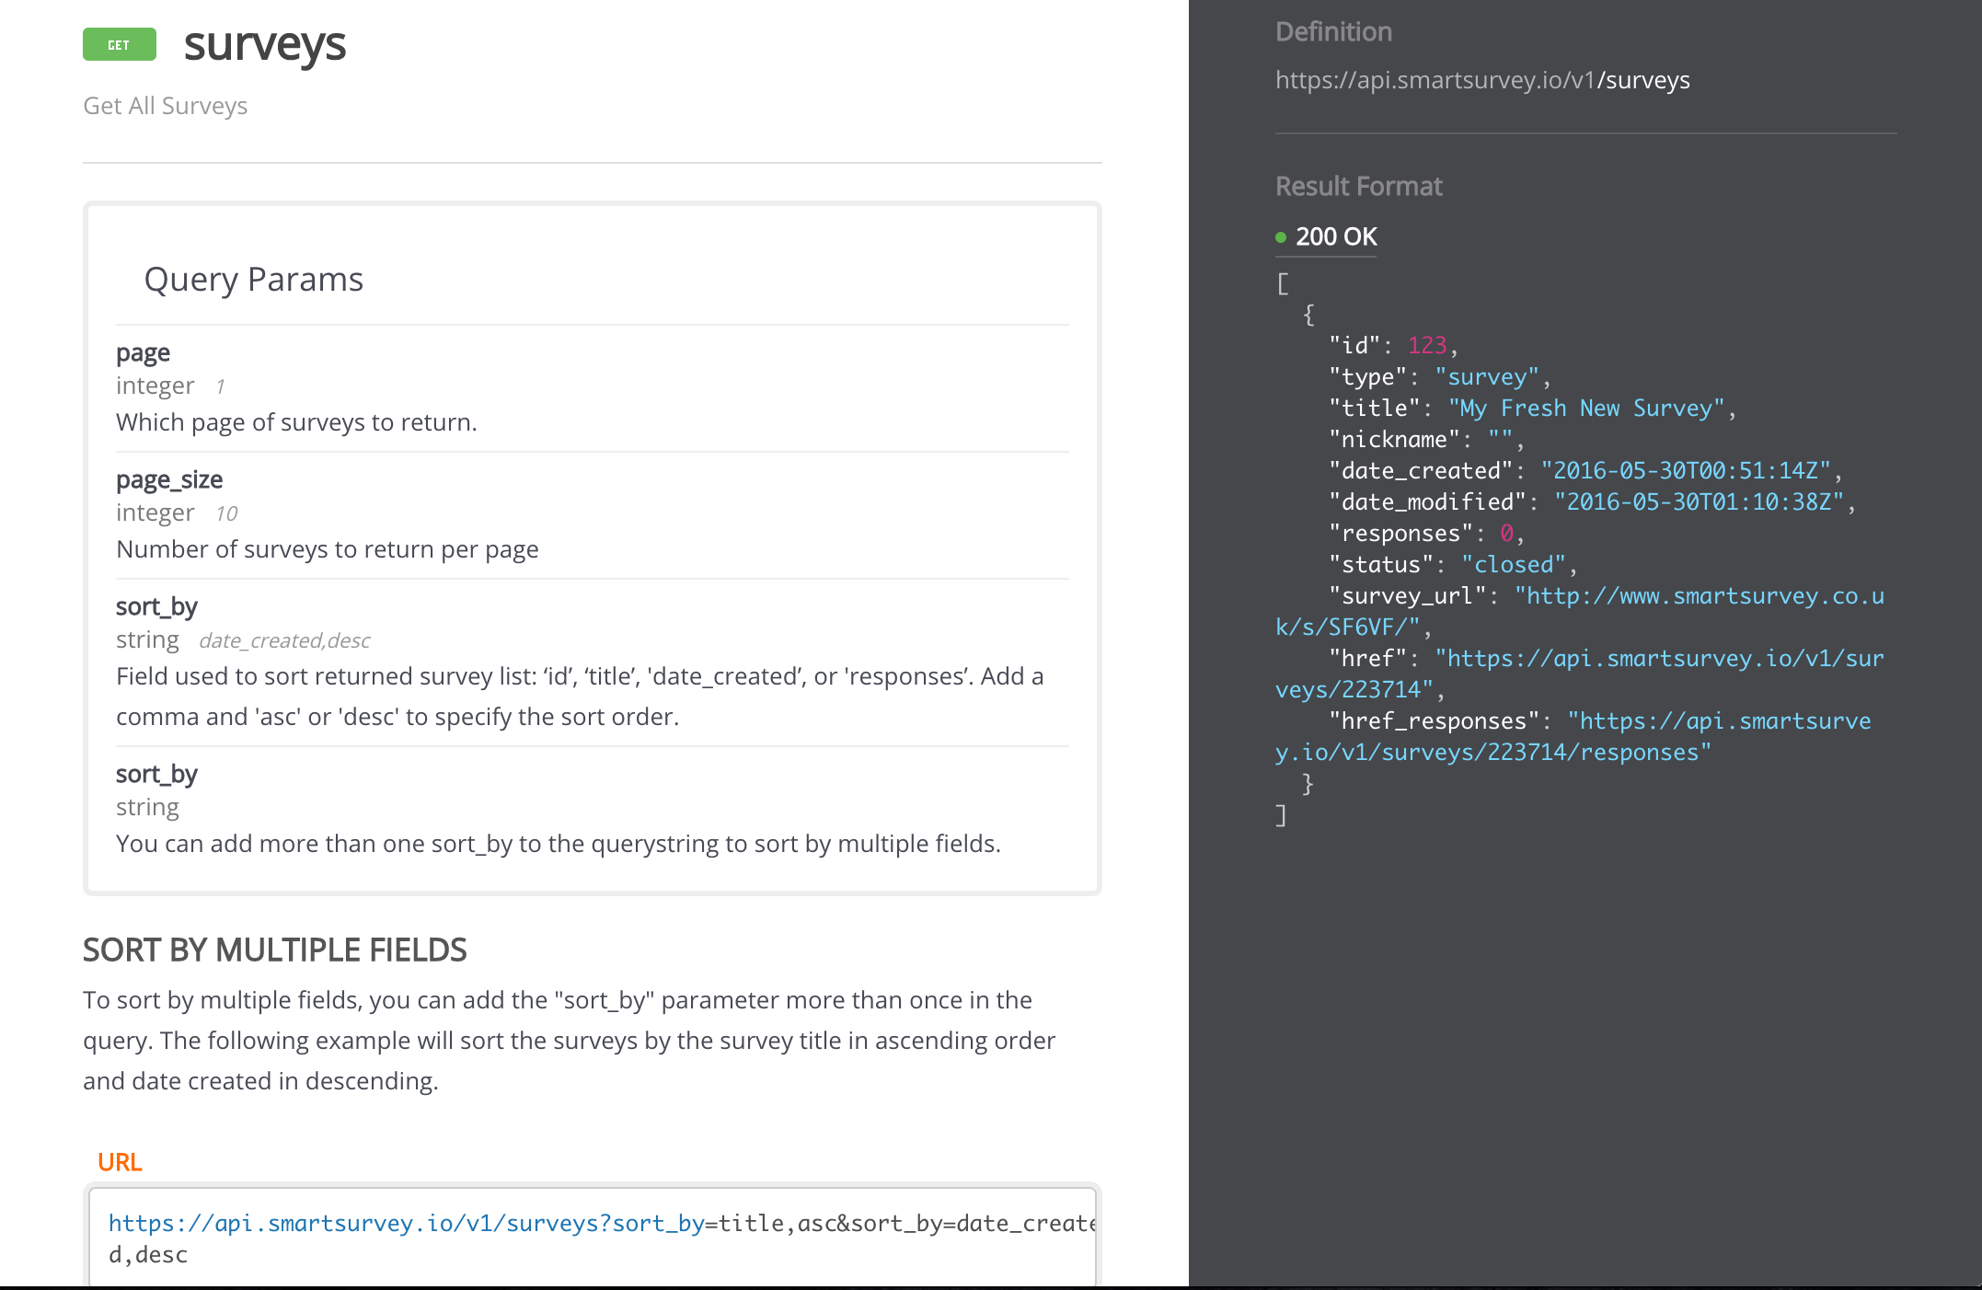
Notes:
Some table styles.

Slide 24
Notes:
Some table styles.

Slide 25
Accessibility
 | Survey Monkey | Smart Survey | Lime Survey
Wave Tool | Fair | Good | Very Poor
Heading Structure | Poor | Very Good | Poor
Error handling | Fair | Very Good | Poor
Keyboard Handling | Good | Good | Very Poor
Magnification | Fair | Fair | Poor
Contrast* | Fair | Fair | Poor
Screen readers | Fair | Good | Poor
Dyslexia / dyspraxia | Fair | Fair | Fair
Notes:
Accessibility notes: Wave: SurveyMonkey had an issue with heading structure. Limesurvey had countless issues including headings, Heading structure: surveymonkey incorrect heading, skips heading on a screenreaderError handling: SmartSurvey screen reader alerts you that there is an error and that you must answer the question to go to the next question. There is an explanation, followed by an in page link to the first error. SurveyMonkey just an alert:not obvious where the error is. Keyboard handling: LimeSurvey stays on the next buttonOther issue: LimeSurvey crashed on dropdown boxes on safari iphoneNo legends for all the survey tools

Slide 26
Data Retention
 | Survey Monkey | Smart Survey | Lime Survey
Hosting location | USA | UK | Internal
Complete data deletion | Probably | Yes | Internal
Automatic deletion | No | No | No
API deletion | Yes | Yes | Yes
Notes:
Some table styles.

Slide 27
Recommendations
Notes:
You can use a colour block like this to help break up presentations, show a new speaker etc.

Slide 28
Home Office Usage
Notes:
You can use a colour block like this to help break up presentations, show a new speaker etc.

Slide 29
Lime Survey
Open source but still costly
Very developer heavy
Overly complex
Notes:
You can:
use simple shapes, graphics and icons in the Home Office Digital colours
mix the colours up but stick to the palette

Slide 30
Survey Monkey
Smart Survey
Performed equally well
Notes:
Survey Monkey – better at creating surveys &reporting
Smart Survey – better at accessibility & technical support

Slide 31
Survey Monkey
Smart Survey
UK vs US datastore
Notes:
Survey Monkey – stores data in US
Smart Survey – stores data in UK

Slide 32
Smart Survey
Recommended
Notes:
Survey Monkey – stores data in US
Smart Survey – stores data in UK

Slide 33
Digital Inclusion Survey
Notes:
You can use a colour block like this to help break up presentations, show a new speaker etc.

Slide 34
Digital Inclusion questionnaire:
can't be created as a simple survey
can be created with some skip logic
may not always save final state
Notes:
Each bullet should read as a full sentence from the lead in line. Use the GOV.UK style guide to be sure.

Slide 35
Digital Inclusion reporting:
requires bespoke solution
data determined by 'exit question'
chart combined questions with Excel
or using API
Notes:
Each bullet should read as a full sentence from the lead in line. Use the GOV.UK style guide to be sure.

Slide 36
Survey Monkey
Smart Survey
UK vs US datastore
Notes:
Survey Monkey – stores data in US
Smart Survey – stores data in UK

Slide 37
Smart Survey
Recommended
Notes:
Survey Monkey – stores data in US
Smart Survey – stores data in UK

Slide 38




Any feedback or questions, please let us know…
Notes:
You can:
use simple shapes, graphics and icons in the Home Office Digital colours
mix the colours up but stick to the palette

Slide 39
Survey Tool Review
Robin Harrison, robin.harrison@digital.homeoffice.gov.uk
Sulthan Ahmed, sulthan.ahmed@digital.homeoffice.gov.uk
Notes:
Use this guide for all internal and external presentations - you can save and overwrite these slides. Before you start, remember to:
keep slides simple and clear - stick to one thing per page with any extra information in the speaker notes
ask people beforehand if they have any additional access needs and what those may be. For example, if they require large print, ask them what size, font, etc and supply them with a copy in landscape format

